Slide 1
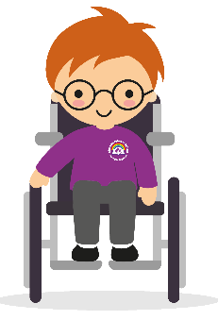
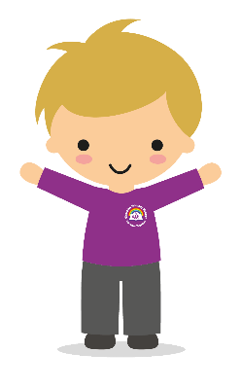
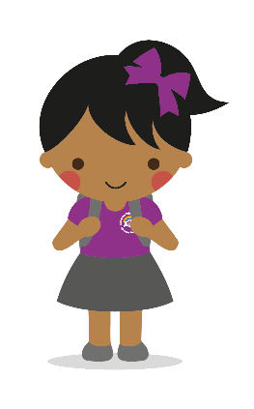
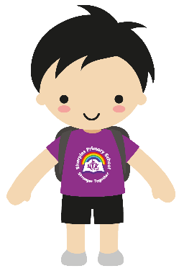
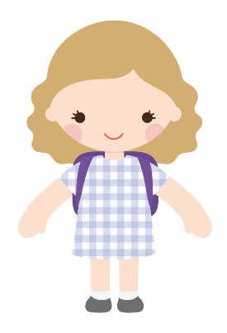
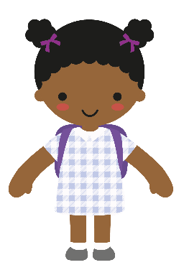
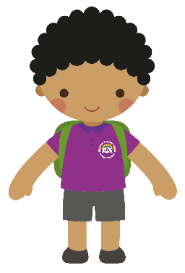
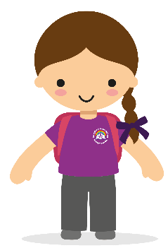
I am a
linguist
I am a
computer
user
I am a
historian
I am a
mathematician
I am a
geographer
I am a
sports
person
Respectful
Aspirational
I am a
scientist
Teamwork
I am a reader and writer or English
Curious
I am an
artist
Determined
I am a
performer
Motivated
I am a
musician
I am a good
citizen
Inclusive
Resilient
I am a
designer and maker
I understand
different
religions

Slide 2
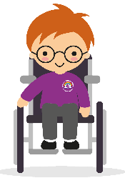
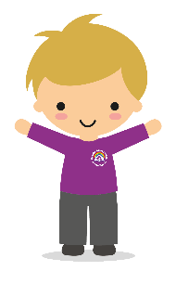
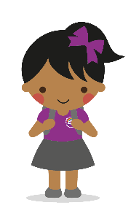
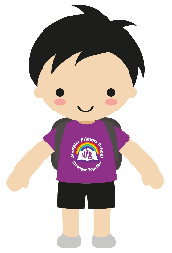
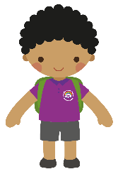
I am a linguist
Learning a different language helps us to deepen our understanding of the world and helps us appreciate diversity in culture and experience. As linguists we learn to express our ideas and thoughts in another language and to understand and respond to its speakers, both in speech and in writing.
I am a computer user
As Computer users, we embrace and utilise new technology in a socially responsible and safe way. Not only will we be digitally literate and competent end-users of technology but through our computer science lessons we will develop creativity, resilience, problem-solving and critical thinking skills.
We will be responsible
digital citizens.
I am a historian
History is the study or the past from the first evidence of human writing. Anything before this is known as prehistory. As historians we use many key skills that can help us to understand the present and make better choices for the future.
History comes from a Greek
word which means “knowledge acquired by investigation”,
which is what we do as
historians. We are like
detectives, investigating what
has happened - and why - using evidence. Evidence
helps us build a clearer,
more accurate
understanding of the past.
I am a mathematician
Maths is the study of numbers, shapes, patterns, quantity and space. As mathematicians we learn about numbers and their place value, how to add, subtract, multiply and divide numbers. We learn what fractions are and how they are related to decimals and percentages. We use our geometry skills to understand position and direction as well as understanding both 2d &
3d shapes as well as our knowledge of time and money.
I am a geographer
Geography is the study of the Earth's physical properties and how they are affected by human activity. As geographers we study physical changes in the environment. When looking at physical geography we study the physical features of the Earth, such as oceans, mountains, rivers, coastlines, forests and plant life. When learning about human
geography we study the
human race and our interactions with the
natural environment.
I am a sports person
As sports people, we have the tools and understanding to develop our health and fitness, physical literacy and emotional well-being in Physical Education (PE) and life. Substantive knowledge in PE is based on deliberate practice and development of specific skills that can be used in a variety of disciplines, sports and games, for example, running, jumping, throwing, catching, balances, movements, tactics, swimming and safe self-rescue.
Respectful
Aspirational
I am a scientist
Science is the study of the natural world through observation and experiment. As scientists, we use the skills of predicting, observing, classifying, measuring, recording, inferring and communicating to help us answer scientific questions about living things and
physical and chemical processes.
I am a reader and writer of English
In English we learn to speak and write fluently so that we can communicate our ideas and emotions to others, and through our reading and listening, we can communicate with each other. Reading also helps us to develop our knowledge and to
build on what we
already know.
Teamwork
Curious
I am an artist
Art and design is the
study, planning and
creation of works that cover visual art (including digital media) painting and drawing, textiles and sculpture. As artists we will appreciate the works of others and create our own pieces that use similar styles and techniques.
Determined
Motivated
I am a performer
In drama we develop our creativity and freedom of expression through taking on different roles. We have opportunities to improvise, devise and script drama for a range of audiences, as well as to rehearse, share and experience different drama and theatre performances.
Inclusive
Resilient
I am a musician
As musicians we play
and perform in solo and ensemble contexts, using our voices, playing musical instruments and using music technology with increasing accuracy, fluency, control and expression. We improvise and compose music for a range of purposes using different aspects of music such as rhythm, tone, pitch, volume and timbre.
I am a good citizen
PSHE is the study of our own personal, social, health and economic education. We learn how to develop to become successful citizens and how to keep ourselves happy, healthy, safe and prepare us for life and work.
I am a designer and
maker
Design technology is the
study of products (including food), their functions and suitability for their desired purpose. As designers and makers we look at, and evaluate, a range of existing products. We design a functional product according to a particular criteria. We discuss ideas and develop annotated sketches and diagrams, prototypes and computer-aided designs before making products that fulfil the purpose we want to achieve.
I understand different religions
In religious education (RE) we explore what people believe and what difference this makes to how they live, so that we can gain the knowledge, understanding and skills needed to handle questions raised by religion and belief and reflect on our own ideas and ways of living.

