Slide 1
Disclaimer/s
We hope you find the information on our website and resources useful.
Animations
This resource has been designed with animations to make it as fun and engaging as possible. To view the content in the correct formatting, please view the PowerPoint in ‘slide show mode’. This takes you from desktop to presentation mode. If you view the slides out of ‘slide show mode’, you may find that some of the text and images overlap each other and/or are difficult to read.
To enter slide show mode, go to the slide show menu tab and select either from beginning or from current slide.
You may wish to delete this slide before beginning the presentation.

Slide 3



Choose the correct item to match the colour.
red

Slide 4


Well done!
Next

Slide 5
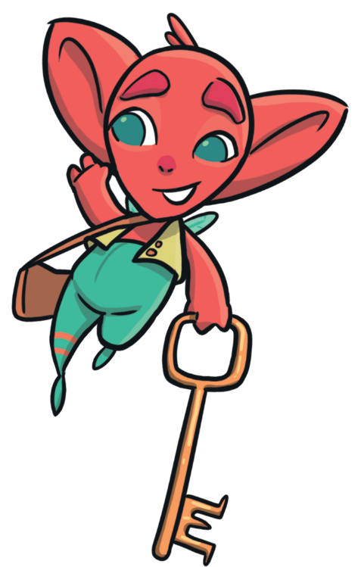
Try again
Back

Slide 6



Choose the correct item to match the colour.
orange

Slide 7
Well done!
Next

Slide 8
Try again
Back

Slide 9
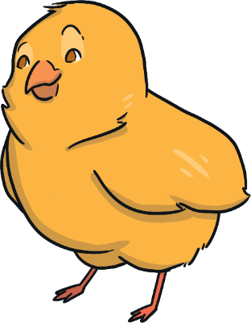


Choose the correct item to match the colour.
yellow

Slide 10
Well done!
Next

Slide 11
Try again
Back

Slide 12
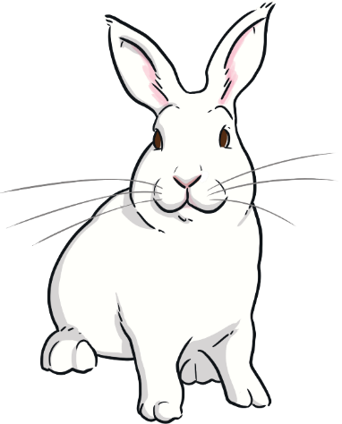


Choose the correct item to match the colour.
green

Slide 13
Well done!
Next

Slide 14
Try again
Back

Slide 15



Choose the correct item to match the colour.
blue

Slide 16
Well done!
Next

Slide 17
Try again
Back

Slide 18

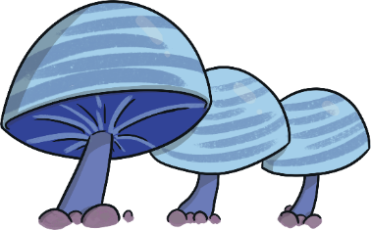

Choose the correct item to match the colour.
indigo

Slide 19
Well done!
Next

Slide 20
Try again
Back

Slide 21

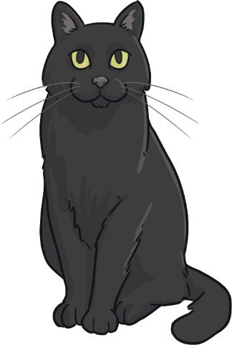
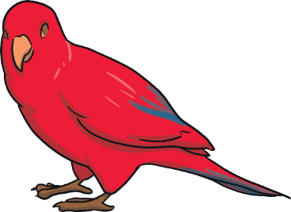
Choose the correct item to match the colour.
violet

Slide 22
Well done!
Next

Slide 23
Try again
Back

Slide 24
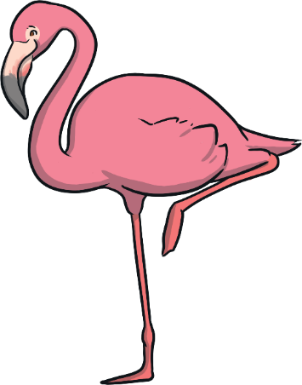

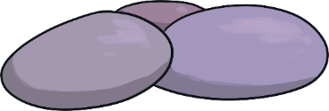
Choose the correct item to match the colour.
pink

Slide 25
Well done!
Next

Slide 26
Try again
Back

Slide 27
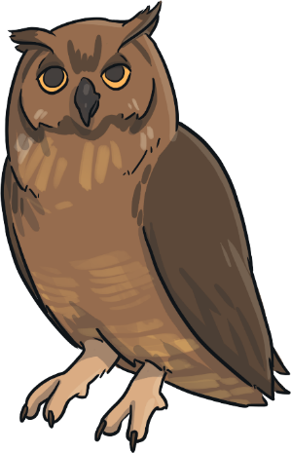


Choose the correct item to match the colour.
brown

Slide 28
Well done!
Next

Slide 29
Try again
Back

Slide 30


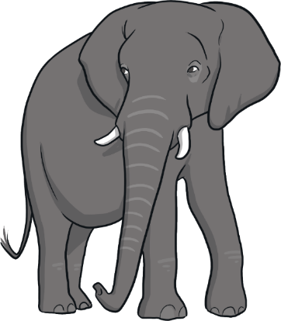
Choose the correct item to match the colour.
grey

Slide 31
Well done!
Next

Slide 32
Try again
Back

Slide 33



Choose the correct item to match the colour.
black

Slide 34
Well done!
Next

Slide 35
Try again
Back

Slide 36



Choose the correct item to match the colour.
white

Slide 37
Well done!
Next

Slide 38
Try again
Back

Slide 39

Choose the correct colour to match the item.
yellow
grey
blue

Slide 40
Well done!
Next

Slide 41
Try again
Back

Slide 42

Choose the correct colour to match the item.
pink
black
orange

Slide 43
Well done!
Next

Slide 44
Try again
Back

Slide 45
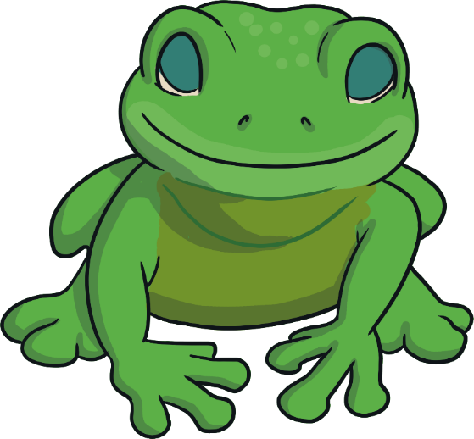
Choose the correct colour to match the item.
brown
green
violet

Slide 46
Well done!
Next

Slide 47
Try again
Back

Slide 48

Choose the correct colour to match the item.
red
yellow
pink

Slide 49
Well done!
Next

Slide 50
Try again
Back

Slide 51

Choose the correct colour to match the item.
orange
blue
white

Slide 52
Well done!
End

Slide 53
Try again
Back

